Slide 1
Machine Learning and Intelligent Data Analysis 2020/21
06-30229 Machine Learning and Intelligent Data Analysis
06-30255 Machine Learning and Intelligent Data Analysis (Extended)
Iain Styles

Slide 2



Module Team
Professor Iain Styles
I.B.Styles@bham.ac.uk
Professor Hamid Dehghani
H.Dehghani@bham.ac.uk
Dr Leandro Minku
L.Minku@bham.ac.uk

Slide 3
About the module…
Machine learning studies how computers can autonomously learn from available data, without being explicitly programmed. The 'information revolution' has generated large amounts of data, but valuable information is often hidden and hence unusable. The module will provide a solid foundation to machine learning and advanced data analysis. It will give an overview of the core concepts, methods, and algorithms for analysing and learning from data. The emphasis will be on the underlying theoretical foundations, illustrated through a set of methods widely used in practice. This will provide the student with a good understanding of how, why and when do various modern machine learning and data analysis methods work.

Slide 4
Learning Outcomes
Demonstrate knowledge and understanding of core ideas and foundations of unsupervised and supervised learning on vectorial data
Explain principles and techniques for mining textual data
Demonstrate understanding of the principles of efficient web-mining algorithms
Demonstrate understanding of broader issues of learning and generalisation in machine learning and data analysis systems
The student should demonstrate the capacity to independently study, understand, and critically evaluate advanced materials or research articles in the subject areas covered by this module.

Slide 5
What’s it really about….?
Leveraging data to answer questions, solve problems, make decisions etc
We do not know how to design algorithms for many important tasks, but we can provide examples of what a programme should do
Programme rules not explicitly designed in by the programmer, but learned from data
A couple of examples

Slide 6
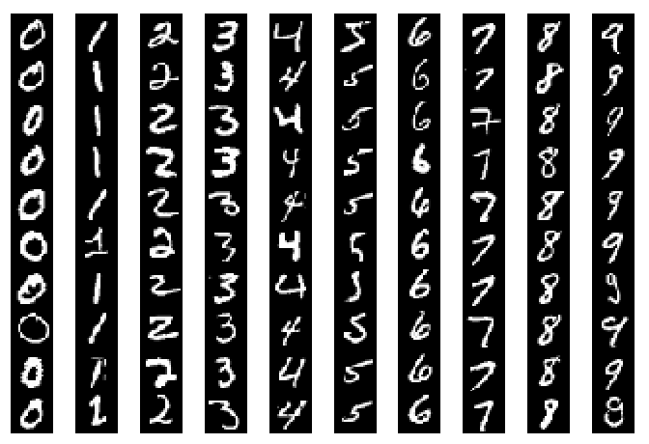

A drop-dead simple approach to classification
?

Slide 7
A drop-dead simple approach to classification
Find the labelled example that looks most like the digit we want to classify
“Nearest neighbour”
Stupidly simple but works amazingly well
Regaining popularity: https://nn2017.mit.edu/

Slide 8
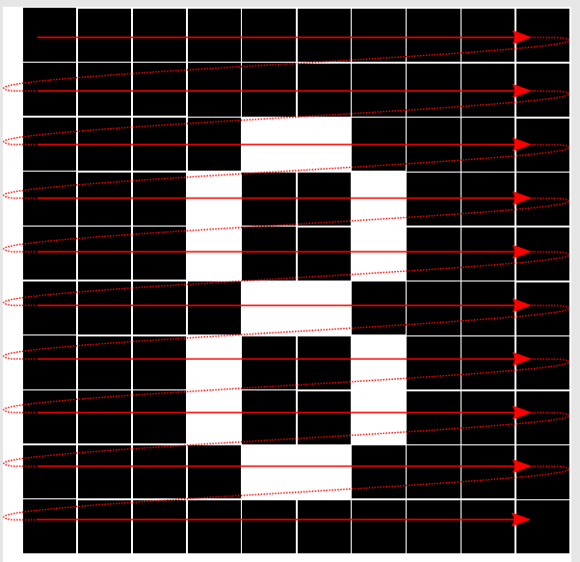
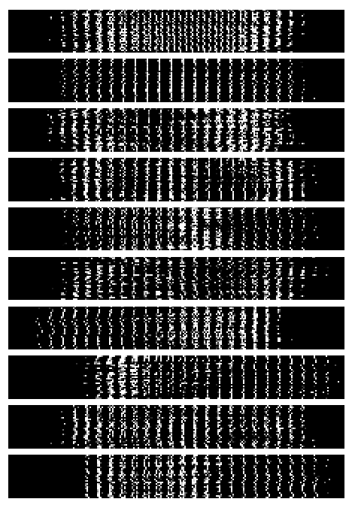

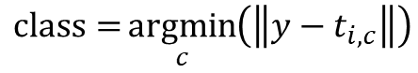
Data-driven character recognition
Minimise distance
$$\text{class}={\underset{c}{argmin}\left(\left\|y−t_{i,c}\right\|\right)}$$

Slide 9
Data-driven character recognition
Prediction
 | 0 | 1 | 2 | 3 | 4 | 5 | 6 | 7 | 8 | 9
0 | 83 | 1 | 1 | 0 | 0 | 0 | 5 | 0 | 10 | 0
1 | 0 | 100 | 0 | 0 | 0 | 0 | 0 | 0 | 0 | 0
2 | 1 | 11 | 53 | 2 | 1 | 0 | 3 | 4 | 25 | 0
3 | 0 | 11 | 2 | 48 | 0 | 1 | 4 | 3 | 28 | 3
4 | 2 | 9 | 0 | 0 | 42 | 0 | 2 | 3 | 16 | 26
5 | 2 | 7 | 0 | 4 | 0 | 36 | 2 | 0 | 43 | 6
6 | 3 | 6 | 0 | 0 | 0 | 1 | 80 | 0 | 10 | 0
7 | 0 | 11 | 0 | 1 | 0 | 0 | 1 | 75 | 4 | 8
8 | 2 | 13 | 0 | 6 | 1 | 3 | 3 | 4 | 65 | 3
9 | 0 | 5 | 1 | 1 | 4 | 0 | 0 | 4 | 2 | 83
True class

Slide 10

Image Infilling
https://nn2017.mit.edu/
https://nn2017.mit.edu/wp-content/uploads/sites/5/2017/12/Efros-NIPS-NN-17.pdf

Slide 11

Image Infilling

Slide 12
Image Infilling

Slide 13
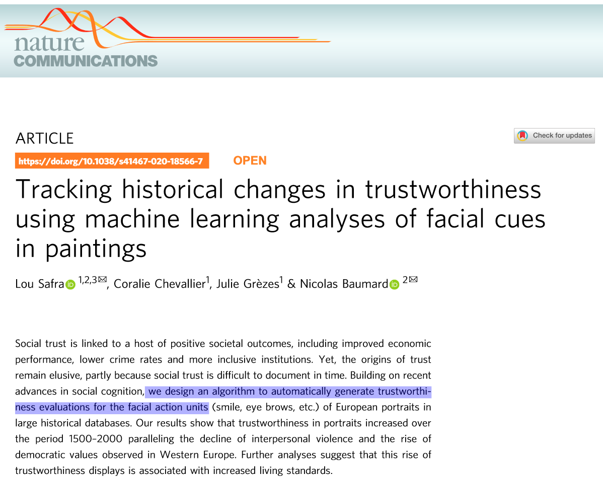
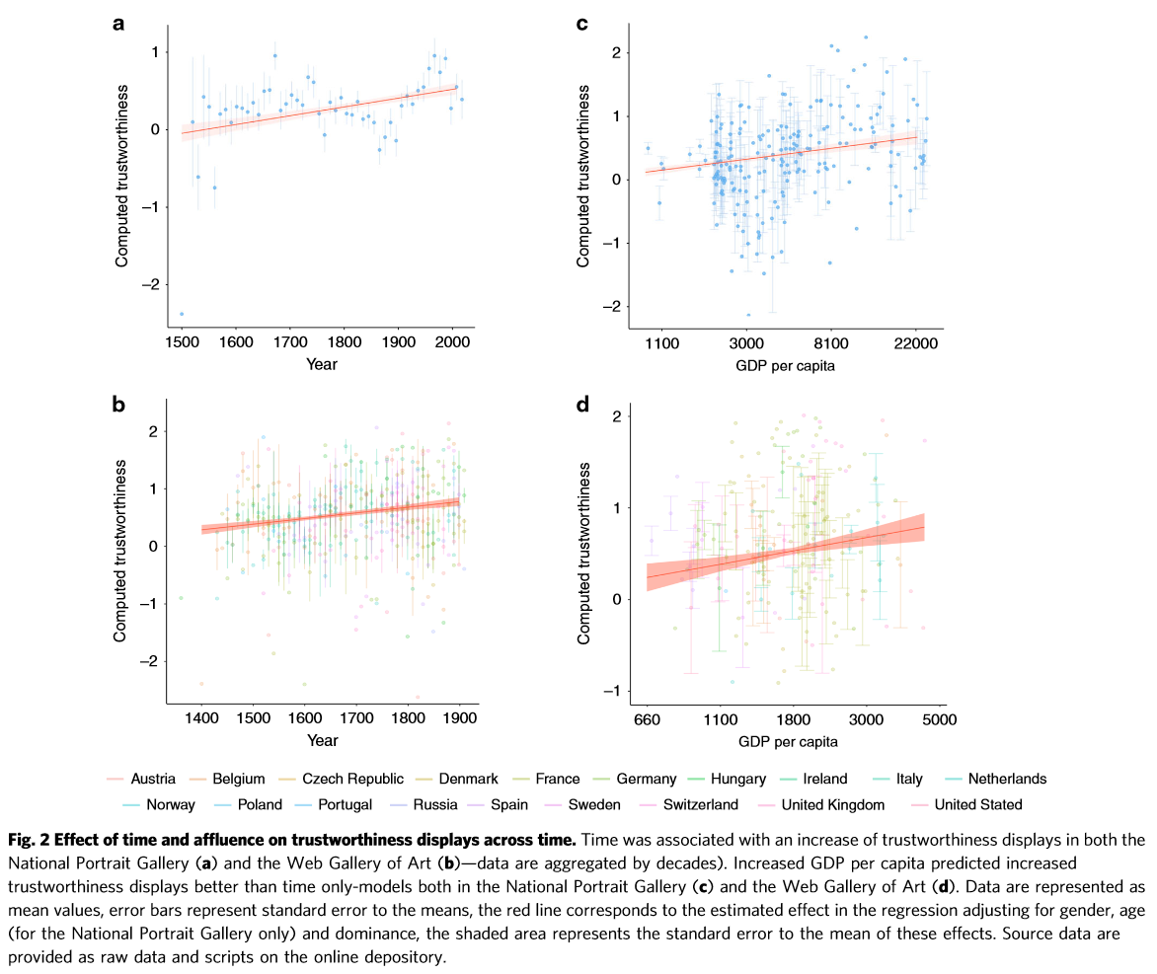

Regression
NATURE COMMUNICATIONS | (2020)11:4728 | https://doi.org/10.1038/s41467-020-18566-7

Slide 14
Module Delivery
All information on Canvas at https://canvas.bham.ac.uk/courses/46228
We will use Teams for general modules queries – please use this rather than email (link on canvas)
There will be some practical work
Assessments:
Weekly quizzes x11 – combined, these will make up 25% of the module mark.
Practical assignment – worth 25%, due week 11. Released mid-term.
Exam – 90 minutes worth 50% in January exam period.

Slide 15
Outline Syllabus (Provision)
28 September | Revision of relevant mathematics | Hamid
5 October | Regression (learning to predict continuous data) | Hamid
12 October | Classification (learning to predict discrete data) | Leandro
19 October | Support vector machine (more advanced classifier) | Leandro
26 October | Ensembles (improving performance by combining learners) | Leandro
2 November | Unsupervised learning (clustering) | Hamid
9 November | Dimensionality reduction (what happens when you have many variables) | Hamid
16 November | Text Analysis (working with non-numeric data) | Iain
23 November | Web mining (measuring document importance) | Iain
30 November | Graphical Models and LDA (probabilistic text analysis) | Iain
7 December | Gaussian Processes (probabilistic regression) | Iain
14 December | Assessment Support Week. | Iain

Slide 16
What’s not on the syllabus
Neural networks (deep or otherwise)
But we will cover many fundamental and general principles that are at the core of the design of modern deep learning approaches
Probabilistic reasoning
Regularisation
Loss functions
Optimisation
Model Selection
Validation
Deep networks are a particular implementation of the ideas we will discuss
Very efficient generalised models that can learn from very large datasets.

Slide 17
Books
Library resource list linked from canvas
Recommended text is “Pattern Recognition and Machine Learning” by Chris Bishop.
Freely available from https://www.microsoft.com/en-us/research/uploads/prod/2006/01/Bishop-Pattern-Recognition-and-Machine-Learning-2006.pdf
Also recommend “The Elements of Statistical Learning” by Hastie, Tibshirani and Friedman – this is listed as the Key Text in the resource list so you can get free access to it.
David Mackay’s excellent book on “Information Theory, Inference, and Learning Algorithms” is freely available from http://www.inference.org.uk/itprnn/book.html
Resource list on canvas at https://canvas.bham.ac.uk/courses/38474/modules/items/1263136

Slide 18
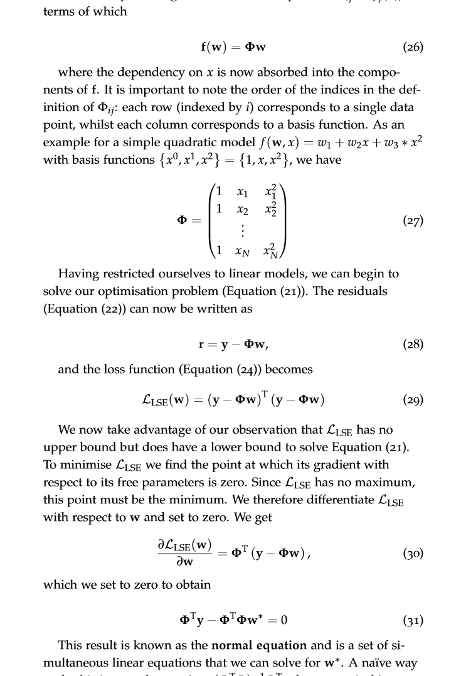
Mathematics
This is not a Maths course, but maths is essential
Linear algebra (matrices, vectors)
Probability (density functions, Bayes’ rule)
Notions from calculus
Refresher notes on canvas

